Slide 1
Real State: Belgian Market
Hui, Mustafa, Georgina
July 15, 2024

Slide 2
What do determine the Price of a property in Belgium?
The annual inflation rate for house prices amounts to 3.1% in the first quarter of 2024 (ref: STATBEL https://statbel.fgov.be/en/themes/housing/house-price-index )
Location
Number of Facades

Slide 3
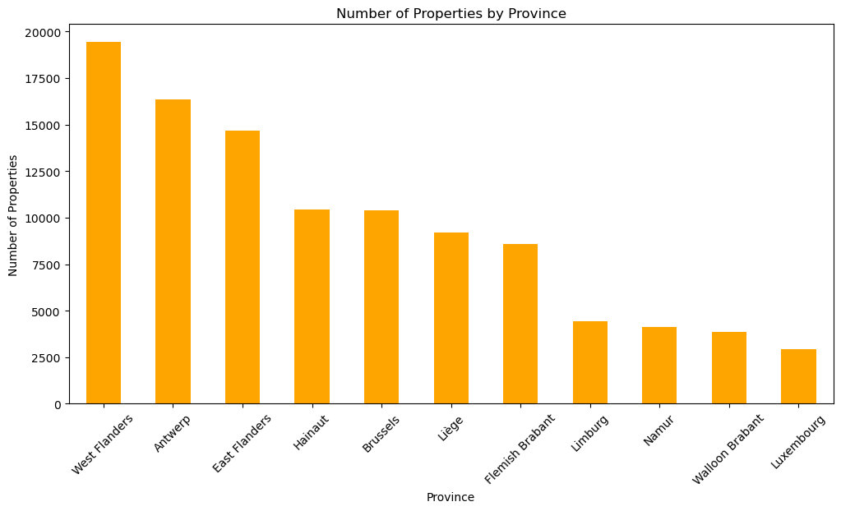
Distribution of Properties
Bruge: 5824
Total: 104472
Antwerp:
9081
Gent:
5055
Brussels:
10411
Liege:
6052

Slide 4
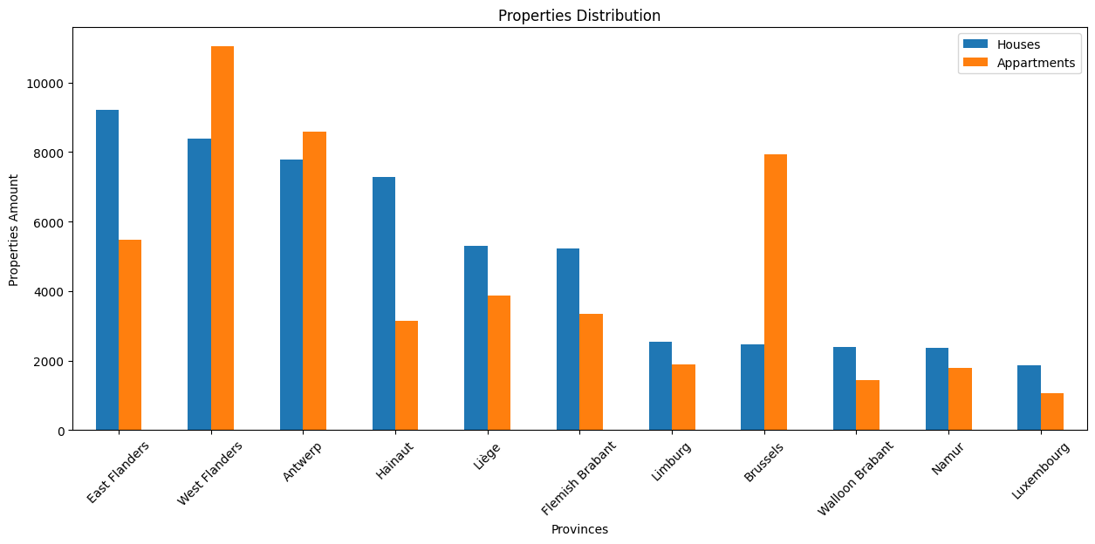
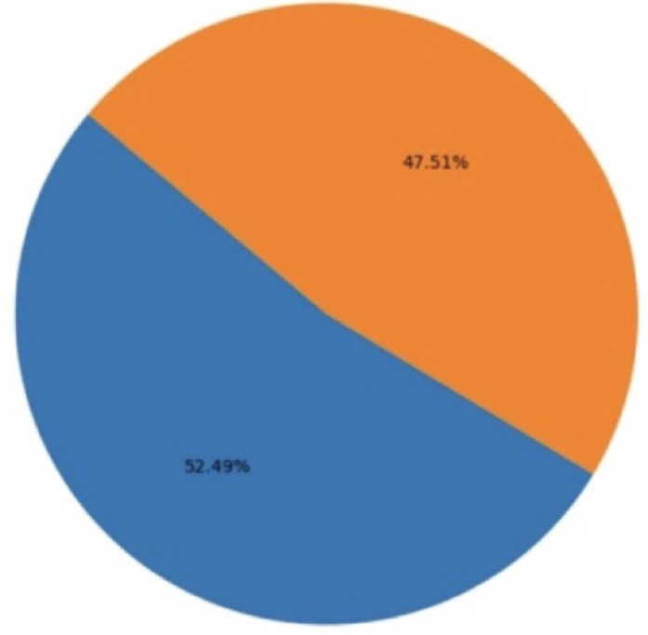
Distribution of Properties
Appartments:
47.51%
Houses:
52.49%

Slide 5
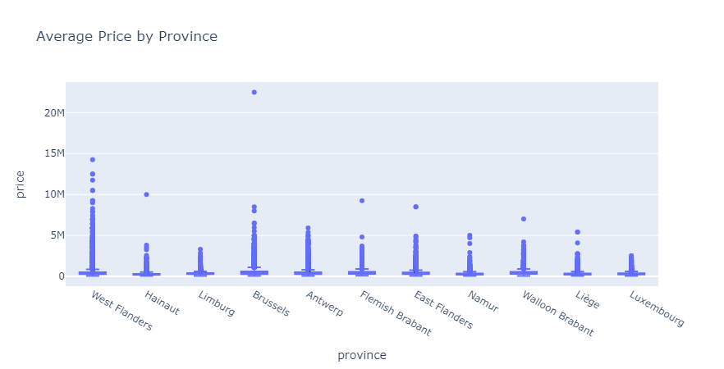

Slide 6
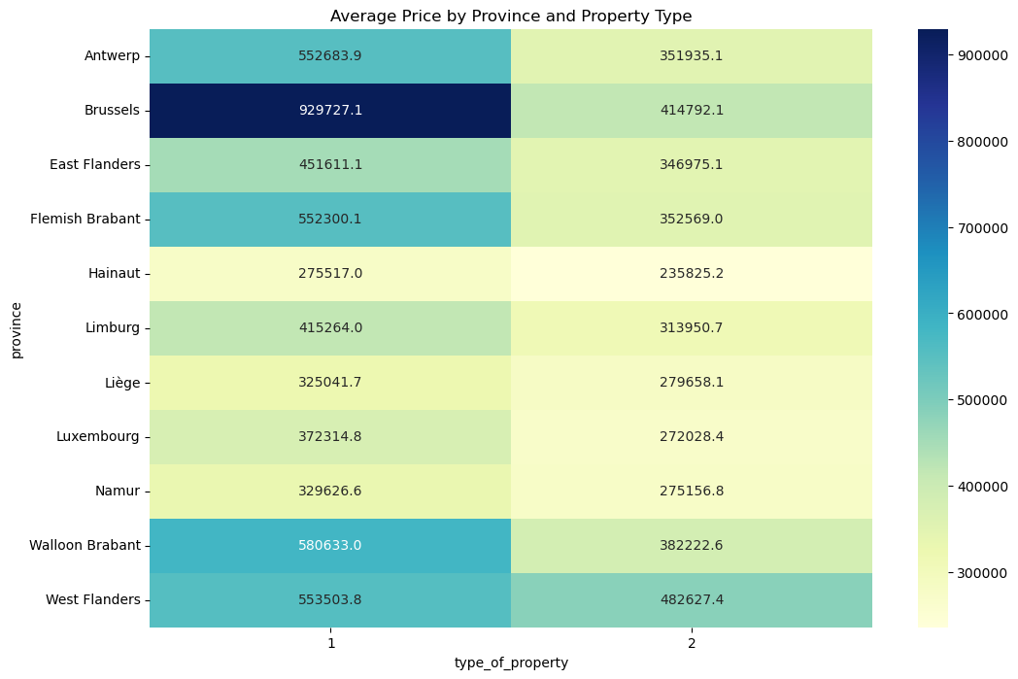

Slide 7
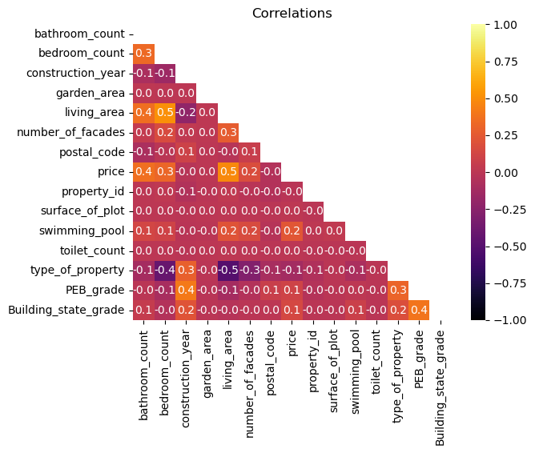

Slide 8
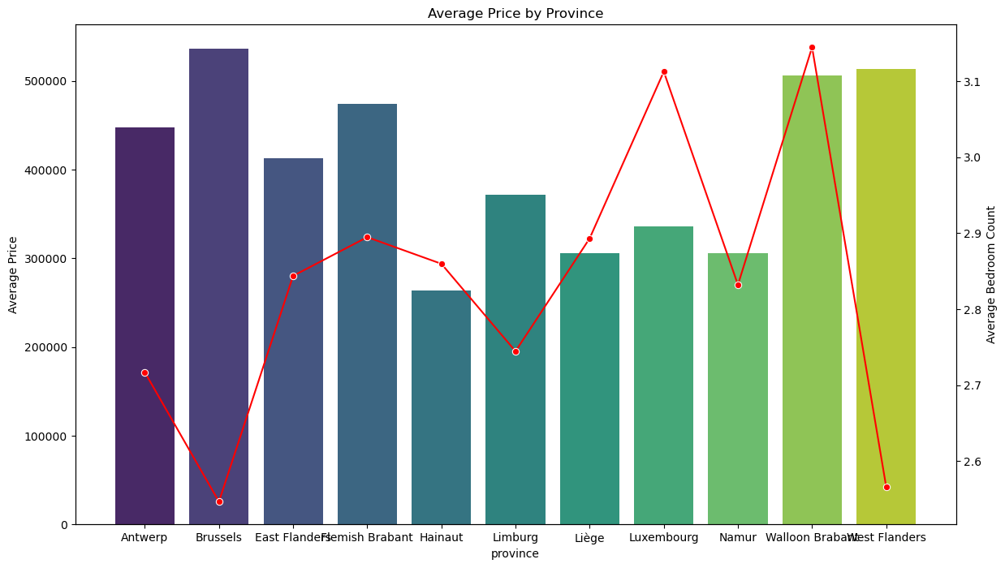

Slide 9
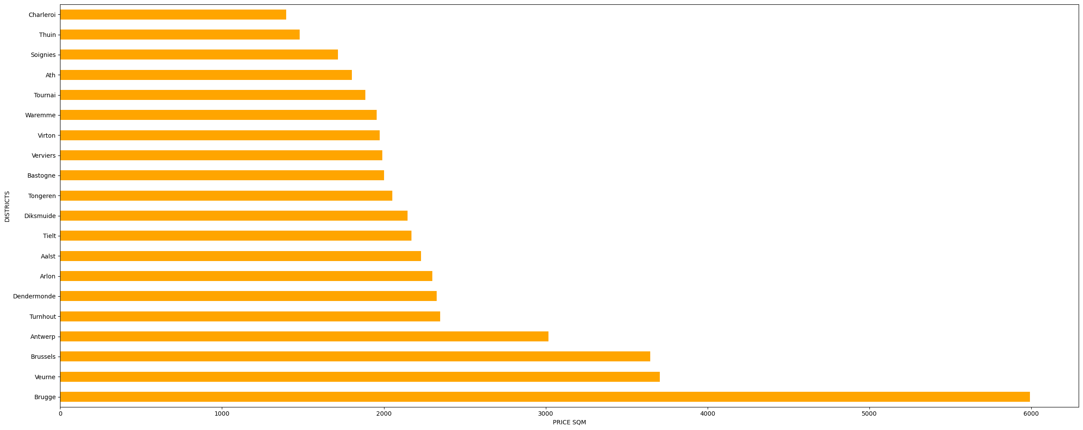

Slide 10
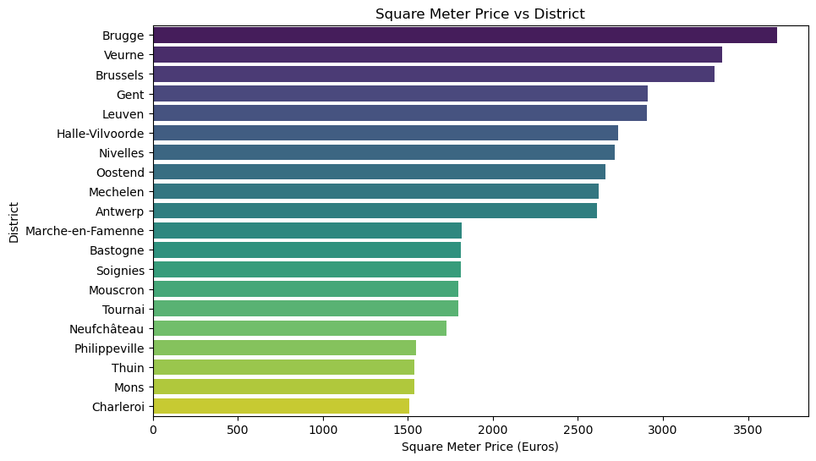

Slide 11
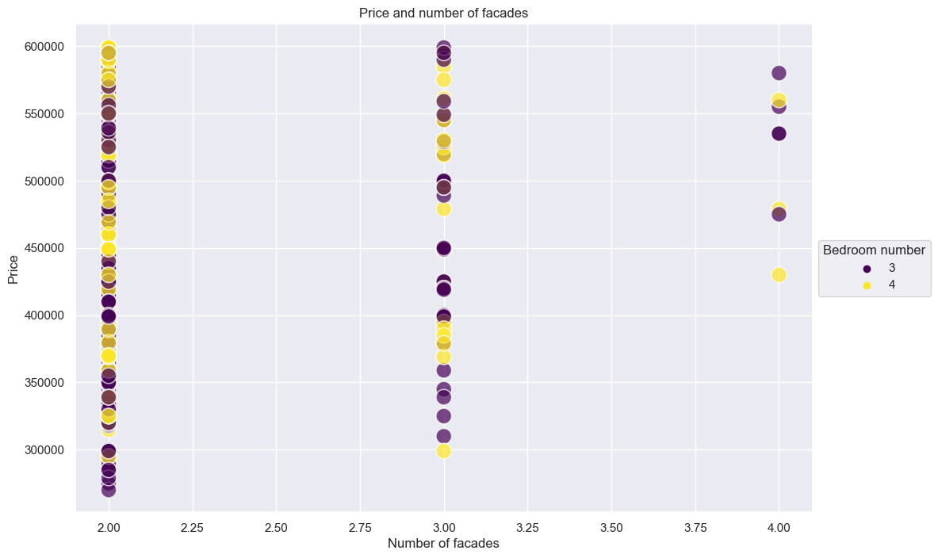

Slide 12
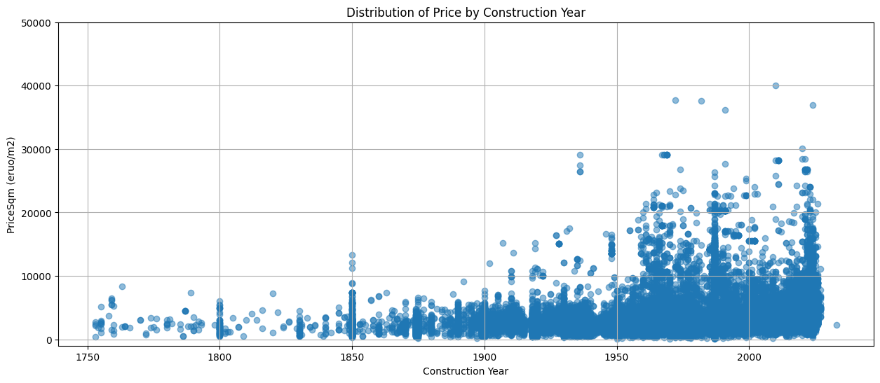
Distribution of Price per Square Meter by Construction Year

